Slide 1
Circulating Cells Keith Hentel, MD MS Executive Vice Chairman Department of Radiology
Cornell Tech : Medical Literacy

Slide 2
A 30 year old male with hemophilia presents to his hematologist with a fever and recent weight loss

Slide 3
A 30 year old male with hemophilia presents to his hematologist with a fever and recent weight loss

Slide 4
hemo- or hemato-
A prefix meaning "blood," as in hemophilia,
a disorder in which blood fails to clot, or hematology, the scientific study of blood.

Slide 5
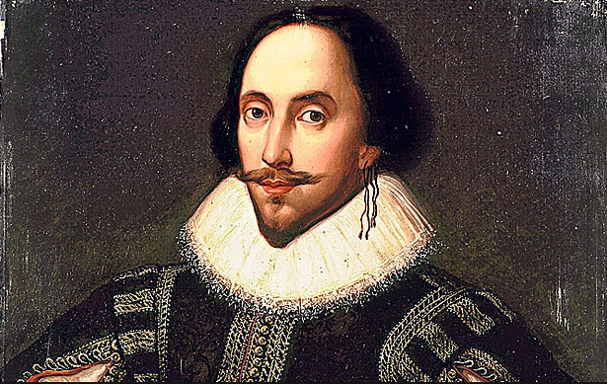
If you prick us, do we not bleed?
Merchant of Venice Act 3 Scene 1

Slide 6
What is in blood?

Slide 7
What is in blood?
PLASMA

Slide 8
What is in blood?
PLASMA
CELLS

Slide 9
PLASMA
Extracellular fluid (ECF) – about 15 quarts in body
Proteins and Electrolytes

Slide 10
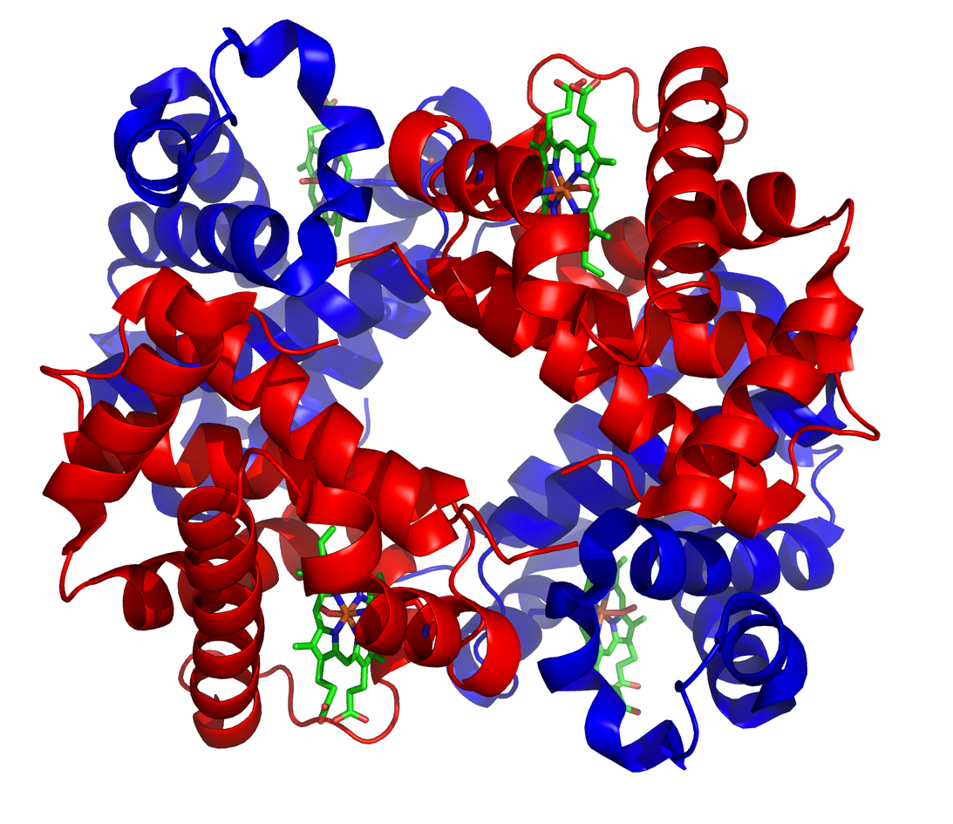
PROTEINS

Slide 11
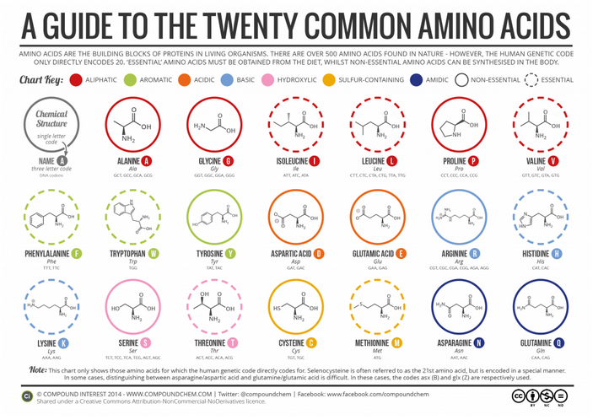
AMINO ACIDS

Slide 12
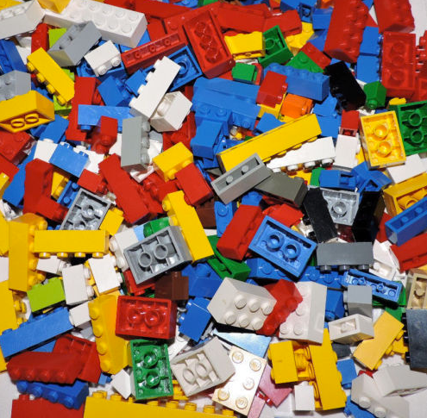
AMINO ACIDS

Slide 13

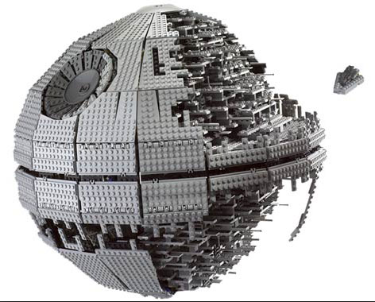
AMINO ACIDS

Slide 14
Electrolytes
Electrolytes refer to minerals that include calcium, chloride, magnesium, phosphate, potassium, and sodium. They are present in your blood, body fluids, and urine. They are ingested with food, drink, and medicines and supplements.
Calcium: hypercalcemia and hypocalcemia
Chloride: hyperchloremia and hypochloremia
Magnesium: hypermagnesemia and hypomagnesemia
Phosphate: hyperphosphatemia and hypophosphatemia
Potassium: hyperkalemia and hypokalemia
Sodium: hypernatremia and hyponatremia

Slide 15
Types of Cells in Blood
Red
White
Platelets

Slide 16
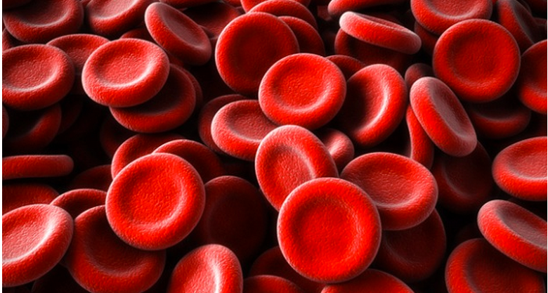
Red Blood Cells

Slide 17
Red Blood Cells
40-45% of blood volume (Hematocrit)
Have no nucleus (more flexible)
Contain hemoglobin which carries Oxygen to the cells of the body and CO2 back to lungs
Last an average of 120 days

Slide 18
Red Blood Cells - Hemoglobin
Bright Red – Lots of O2
Dark Red – Lots of CO2

Slide 19
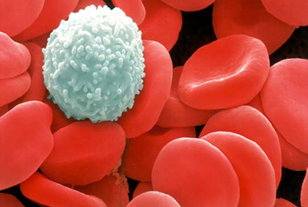
White Blood Cells

Slide 20
White Blood Cells
1% of blood volume
Neutrophils/Lymphocytes/Macrophages
Protect the body from infection

Slide 21
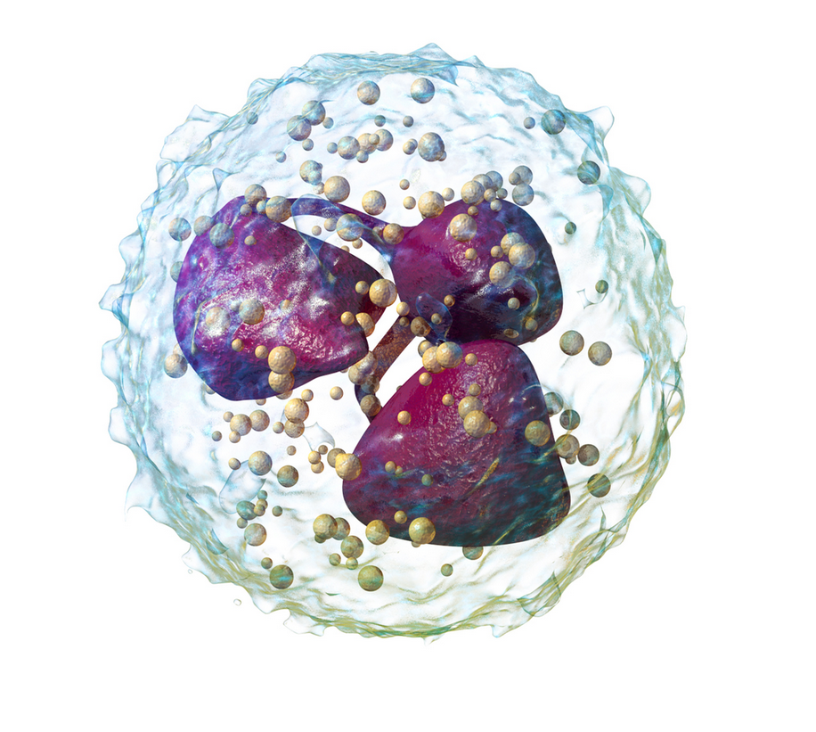
Neutrophils
55% to 70% of all white cells
Last about 1 day
Transfusion not effective
First responders
Phagocytosis
https://en.wikipedia.org/wiki/Neutrophil_granulocyte

Slide 22
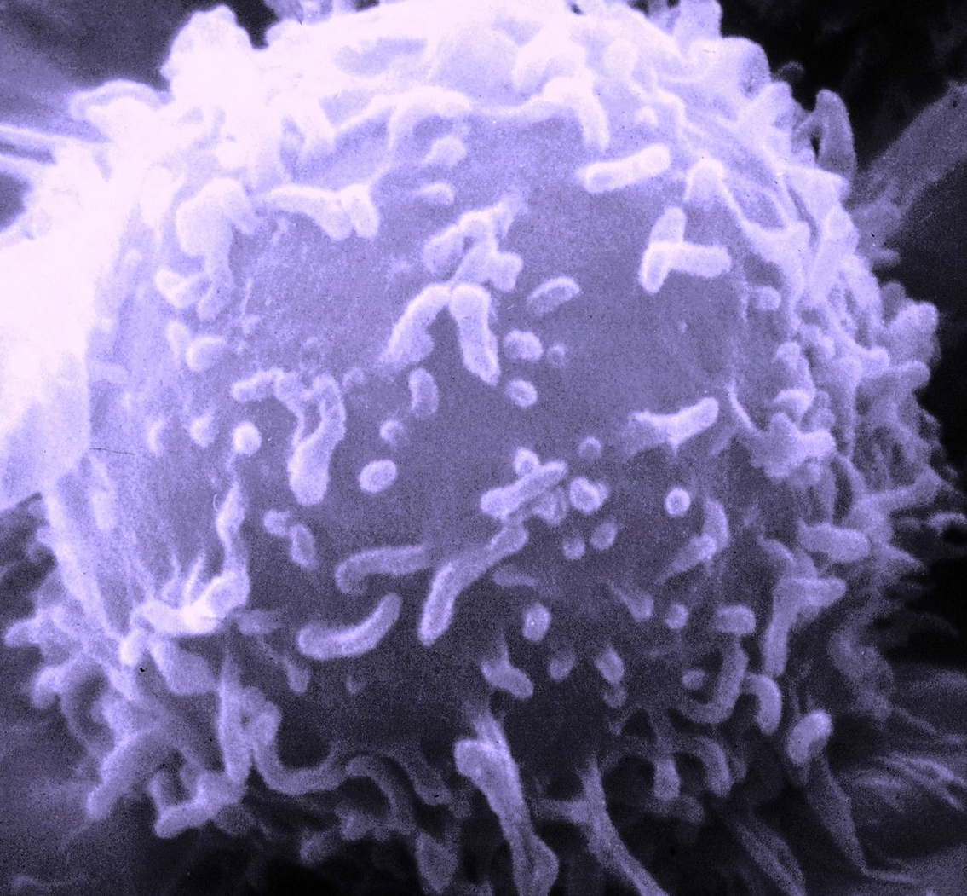
Lymphocytes
T lymphocytes – regulate other immune cells and directly attack infected cells and cancer cells
B lymphocytes (make antibodies) which are proteins that specifically target bacteria, viruses, and other pathogens
Change into plasma cells to make antibodies
https://en.wikipedia.org/wiki/Lymphocyte#/media/File:SEM_Lymphocyte.jpg

Slide 23
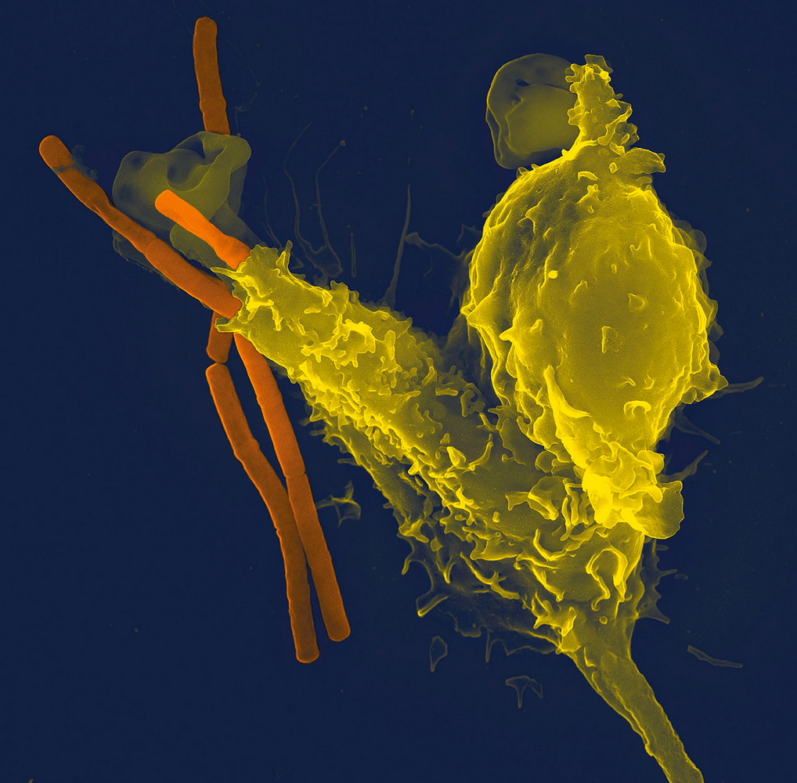
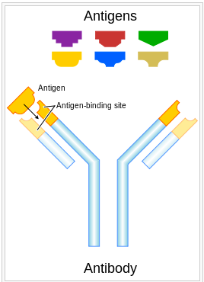
Antibodies
Also known as an immunoglobulin
Each antibody recognizes a unique pathogen
https://en.wikipedia.org/wiki/Neutrophil_granulocyte#/media/File:Neutrophil_with_anthrax_copy.jpg

Slide 24
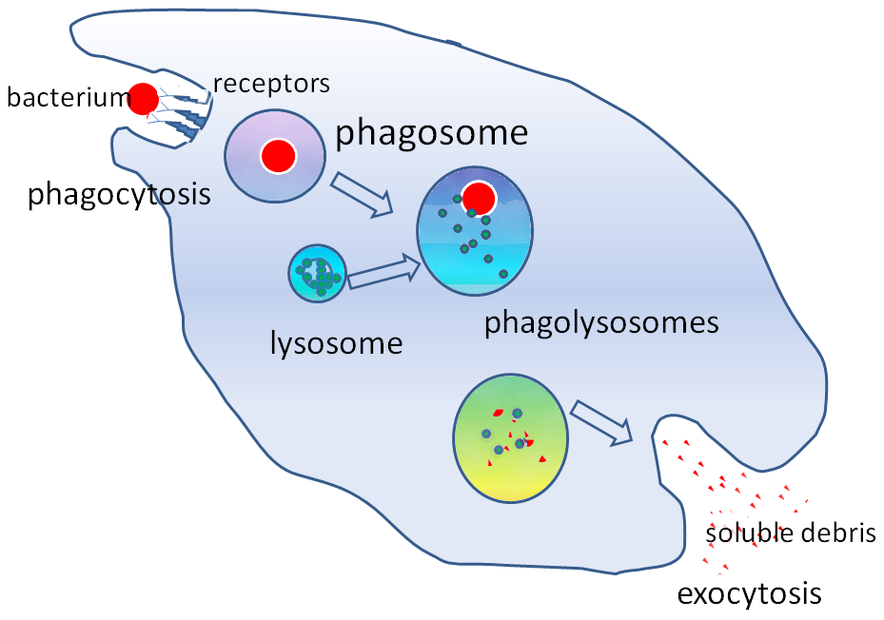
Macrophages
Take in pathogens and foreign materials and destroys
https://en.wikipedia.org/wiki/Phagocyte#/media/File:Phagocytosis2.png

Slide 25
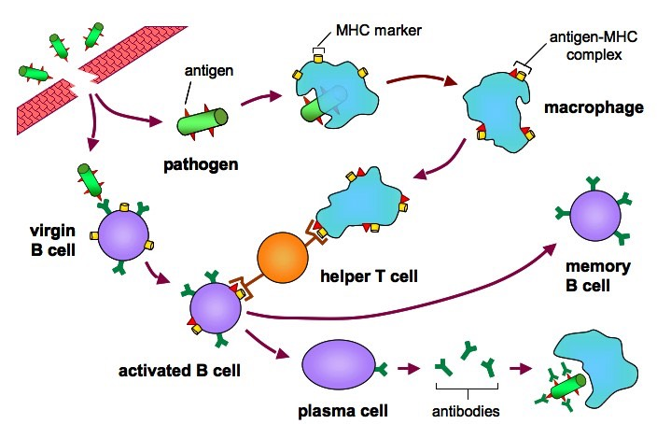

Slide 26
Hematopoeisis
Formation of blood cellular components
Start with a hematopoeitic stem cells (HSC)
Over 10¹⁰ to 10¹¹ blood cells formed per day
Typically occurs in the bone marrow

Slide 27
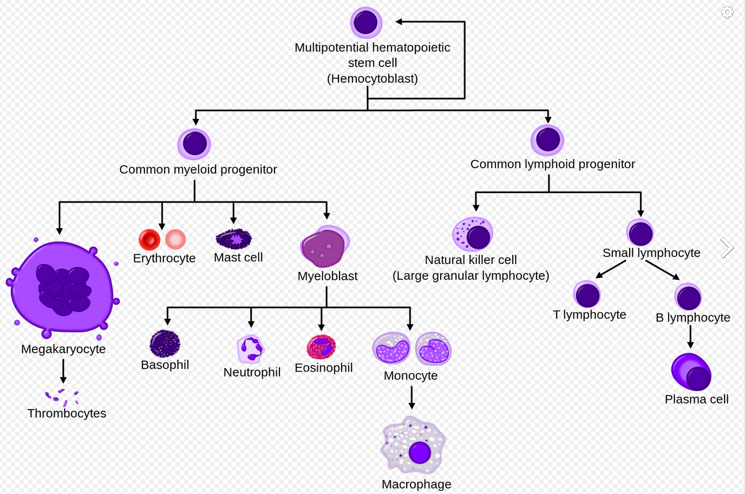
Hematopoeisis
https://en.wikipedia.org/wiki/Haematopoiesis#/media/File:Hematopoiesis_simple.svg

Slide 28
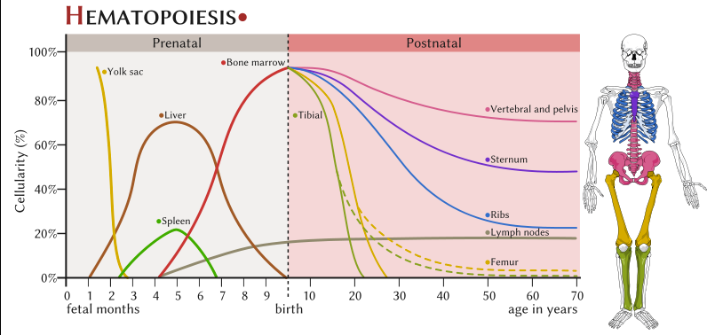
Hematopoeisis
https://en.wikipedia.org/wiki/Haematopoiesis#/media/File:Hematopoesis_EN.svg

Slide 29
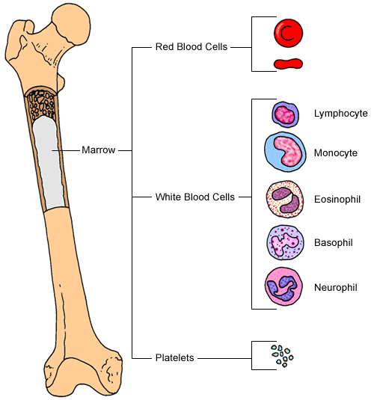
Bone Marrow
https://en.wikipedia.org/wiki/Haematopoiesis#/media/File:Hematopoesis_EN.svg

Slide 30
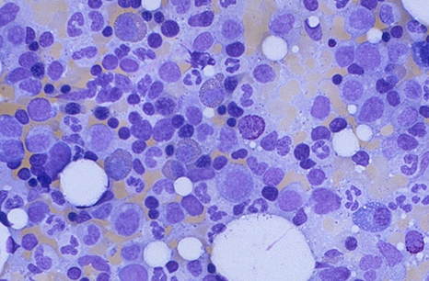
Bone Marrow
library.med.utah.edu

Slide 31
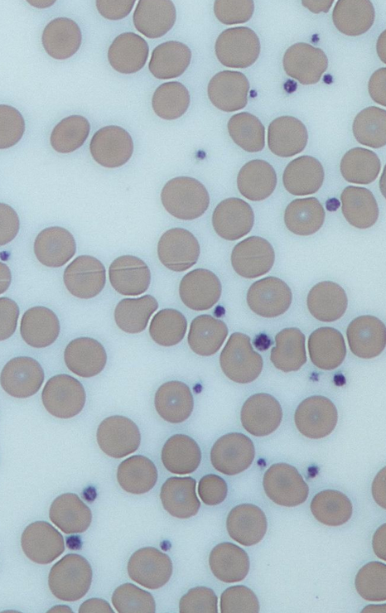
Platelets
Fragments of cells that stop bleeding by clumping together to achieve hemostasis
Will also release signals to activate clotting pathways
Live 8-9 days

Slide 32
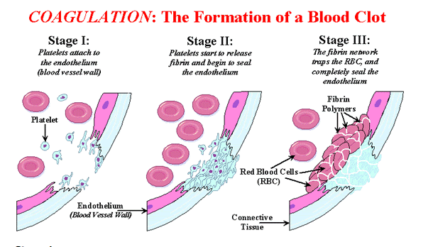
Blood Clotting
http://www.womens-health-advice.com/heart-disease/coagulation.html

Slide 33
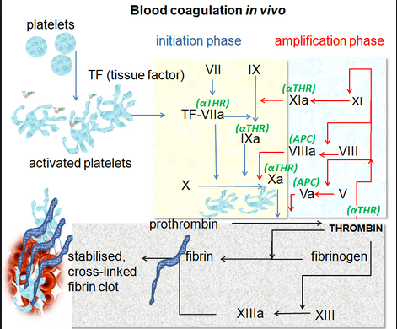
Blood Clotting
en.wikipedia.org

Slide 34
Blood Clotting
en.wikipedia.org

Slide 35
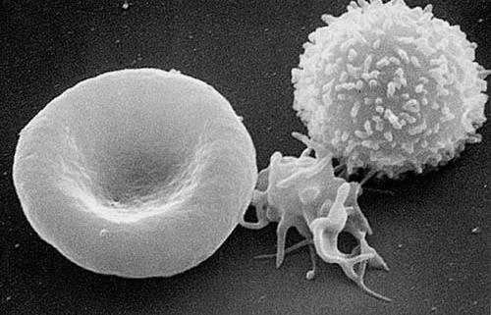
Circulating Cells
https://en.wikipedia.org/wiki/Platelet#/media/File:Red_White_Blood_cells.jpg

Slide 36
Circulating Cells
Red Bloods Cells – Transport O2 so cells can produce energy
White Blood Cells – Fight infection and toxins
Platelets – Stop bleeding

Slide 37

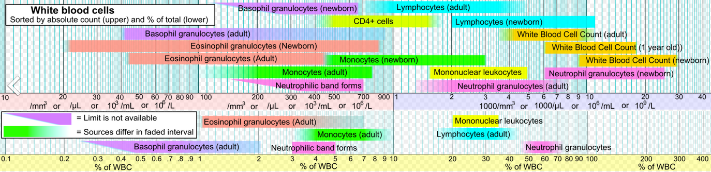
CBC with Diff
https://en.wikipedia.org/wiki/Complete_blood_count

Slide 38
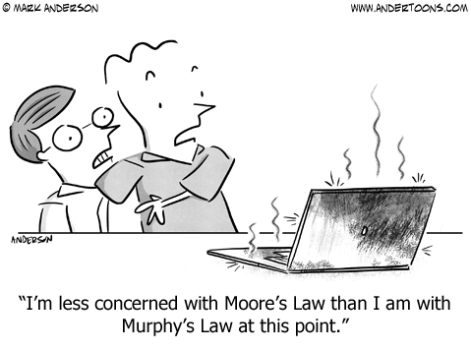
Circulating Cells

Slide 39
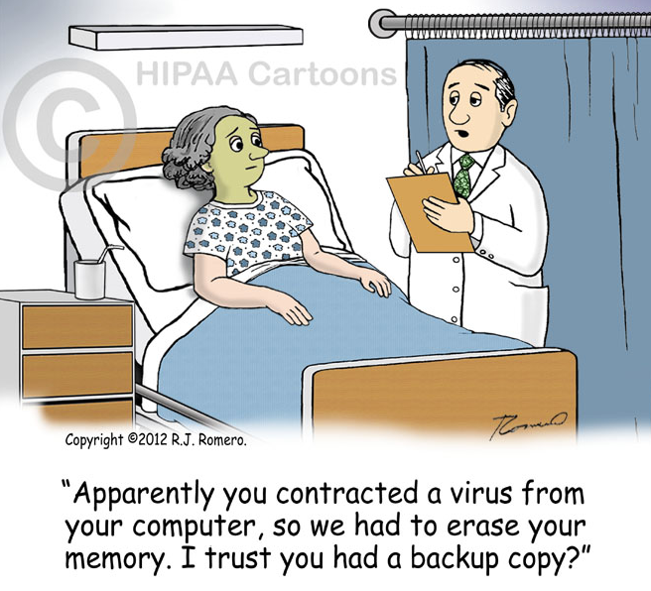
Circulating Cells

Slide 40
Lab Results
Normal
Normal
Low
Normal

Slide 41
Thrombocytopenia – Low platelets
Presents with
Bleeding ( nosebleeds, bleeding gums, etc)
Purpura (Bruising)
Petechia ( pinpoint painless bleeds in skin)
effects of blood loss

Slide 42
Thrombocytopenia – Low platelets
Causes:
Decreased production
Increased destruction
Medication induced
Snakebite

Slide 43
Lab Results
Low
Normal
Normal
Low

Slide 44
Amenia – Low RBC’s or Hemoglobin
Presents with:
Feeling Tired
Poor concentration
Weakness
Shortness of Breath
Confusion
Feeling like you will pass out
Thirst

Slide 45
Amenia – Low RBC’s or Hemoglobin
3 Major categories:
Blood Loss (GI bleed, trauma)
Decreased RBC production (Iron deficiency, bone marrow)
Increased RBC destruction (Sickle cell anemia, Malaria)

Slide 46
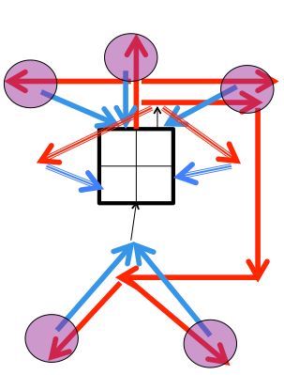
Amenia – Low RBC’s or Hemoglobin

Slide 47
Amenia – Low RBC’s or Hemoglobin

Slide 48
Amenia – Low RBC’s or Hemoglobin

Slide 49
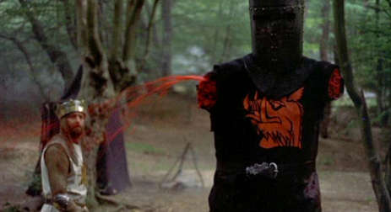
Amenia – Low RBC’s or Hemoglobin

Slide 50
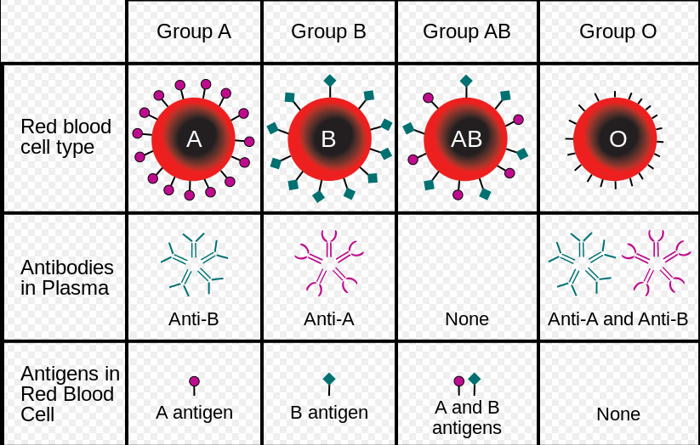
Amenia – Low RBC’s or Hemoglobin
https://en.wikipedia.org/wiki/Blood_type#/media/File:ABO_blood_type.svg

Slide 51
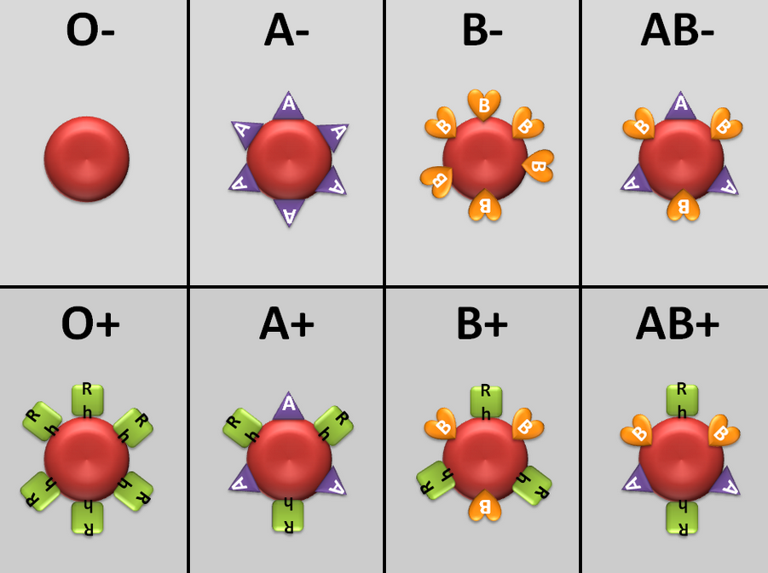
Amenia – Low RBC’s or Hemoglobin
http://pleasepressreset.com/home/shit-we-forgot/rh-blood-type/

Slide 52
Lab Results
Normal
High
Normal
Normal

Slide 53
Leukocystosis – Too many WBC’s
Caused by :
Infections
Neoplastic proliferation (e.g. leukemia)
Allergic disorders
Inflammation
Tissue death (Necrosis)
Type of WBC’s help to determine the underlying cause

Slide 54
Lab Results
Normal
Low
Normal
Normal

Slide 55
Leukopenia – Not enough WBC’s
Caused by :
Acute Viral Infections
Chemotherapy/Radiation therapy
Bone marrow disorders
Chronic viral infection (HIV)
Enlarged spleen

Slide 56
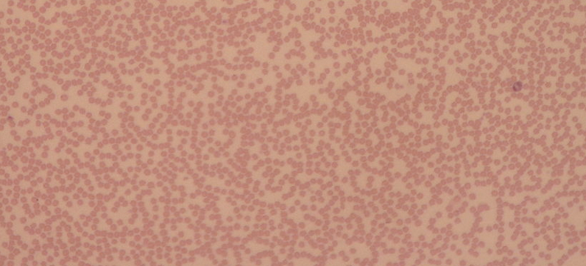
Leukopenia – Not enough WBC’s
Neutropenia most common form
Patients at high risk for bacterial infection

Slide 57
Our patient
A 30 year old male with hemophilia presents to his hematologist with a fever and recent weight loss

Slide 58
Lab Results
Normal
Normal
Normal
Normal

Slide 59
Lab Results
Normal
Normal
Normal
Normal
An additional test was performed

Slide 60
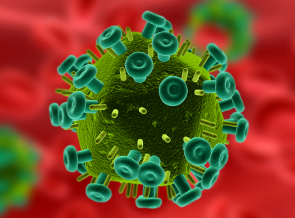
HIV
http://www.kurzweilai.net/protein-that-destroys-hiv-discovered

Slide 61
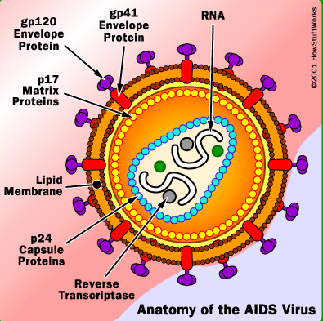
HIV
http://science.howstuffworks.com/life/cellular-microscopic/aids2.htm

Slide 62
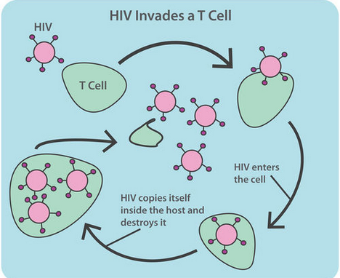
HIV
www.ck12.org

Slide 63
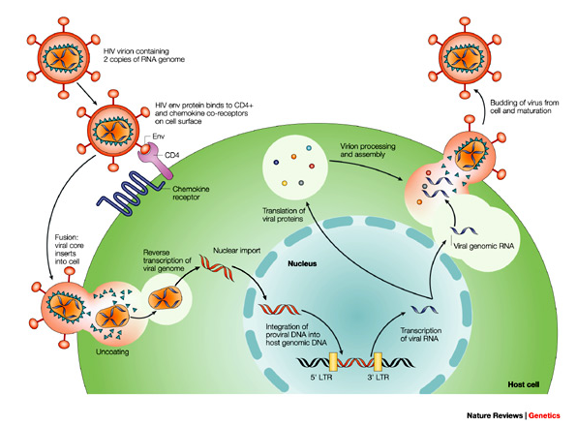
HIV
http://www.nature.com/nrg/journal/v5/n1/fig_tab/nrg1246_F1.html

Slide 64
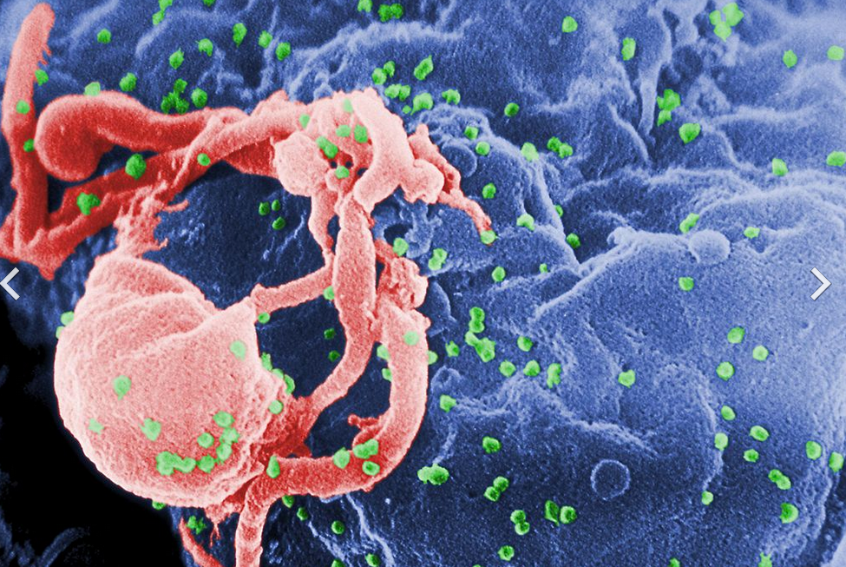
HIV
https://en.wikipedia.org/wiki/HIV/AIDS#/media/File:HIV-budding-Color.jpg

Slide 65
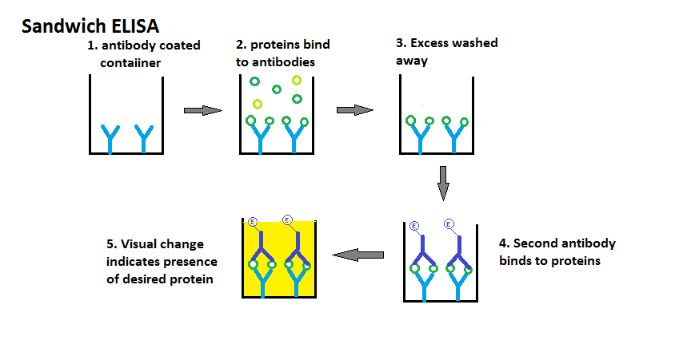
HIV test - ELISA
https://upload.wikimedia.org/wikipedia/commons/c/c4/Sandwich_ELISA.png

Slide 66
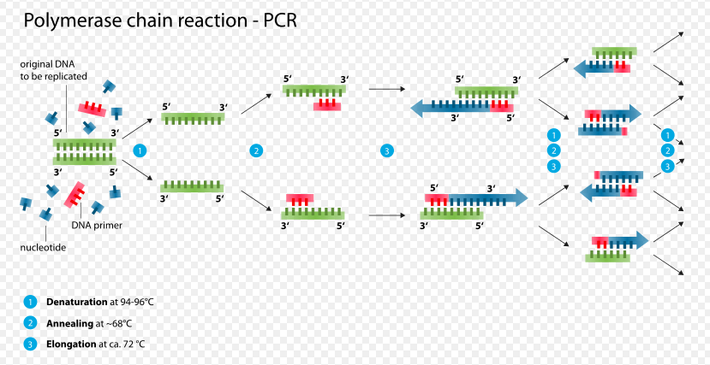
HIV test - PCR
https://en.wikipedia.org/wiki/Polymerase_chain_reaction#/media/File:Polymerase_chain_reaction.svg

Slide 67
CD4 Helper T cells

Slide 68
CD4 Helper T cells
Less than 200 cells per uL
Defines the presence of AIDS

Slide 69
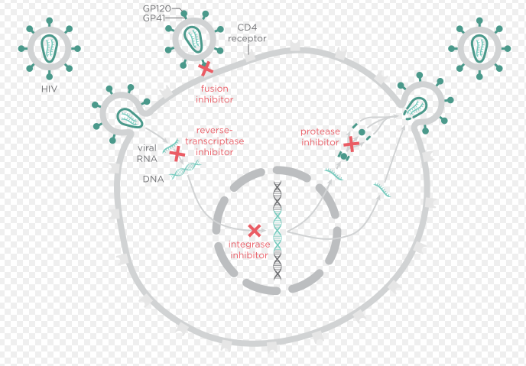
HIV treatment

Slide 70
Thank You !!

Slide 71
Glossary of Terms

Slide 72
Glossary
Hemophilia : a medical condition in which the ability of the blood to clot is severely reduced, causing the sufferer to bleed severely from even a slight injury. The condition is typically caused by a hereditary lack of a coagulation factor, most often factor VIII.
Hematologist :A physician trained and experienced in hematology, i.e., skilled in the diagnosis of diseases of the blood and bone marrow, or in treatment of such diseases, or both.

Slide 73
Glossary
Amino Acids : Any of a large number of compounds found in living cells that contain carbon, oxygen, hydrogen, and nitrogen, and join together to form proteins. Amino acids contain a basic amino group (NH2) and an acidic carboxyl group (COOH), both attached to the same carbon atom.
Hemoglobin : a red protein responsible for transporting oxygen in the blood of vertebrates. Its molecule comprises four subunits, each containing an iron atom bound to a heme group.

Slide 74
Glossary
Amino Acids : Any of a large number of compounds found in living cells that contain carbon, oxygen, hydrogen, and nitrogen, and join together to form proteins. Amino acids contain a basic amino group (NH2) and an acidic carboxyl group (COOH), both attached to the same carbon atom.
Hemoglobin : a red protein responsible for transporting oxygen in the blood of vertebrates. Its molecule comprises four subunits, each containing an iron atom bound to a heme group.

Slide 75
Glossary
Hematocrit : the ratio of the volume of red blood cells to the total volume of blood.
Phagocytosis : the ingestion of bacteria or other foreign material by phagocytes
Antibodies : a blood protein produced in response to and counteracting a specific antigen. Antibodies combine chemically with substances that the body recognizes as alien, such as bacteria, viruses, and foreign substances in the blood.

Slide 76
Glossary
Stem Cell : an undifferentiated cell of a multicellular organism that is capable of giving rise to indefinitely more cells of the same type, and from which certain other kinds of cell arise by differentiation.
Hematopoeisis : the production of blood cells and platelets, which occurs in the bone marrow.

Slide 77
Glossary
hemostasis: the stopping of a flow of blood.
thrombocytopenia : deficiency of platelets in the blood. This causes bleeding into the tissues, bruising, and slow blood clotting after injury.
Leukocytosis : an increase in the number of white cells in the blood, especially during an infection.

Slide 78
Glossary
Anemia : a condition marked by a deficiency of red blood cells or of hemoglobin in the blood, resulting in pallor and weariness.
leukopenia : a reduction in the number of white cells in the blood, typical of various diseases.
Neutropenia : the presence of abnormally few neutrophils in the blood, leading to increased susceptibility to infection. It is an undesirable side effect of some cancer treatments.

